Slide 1
Design and Analysis of Algorithms (UE20CS251)
Unit V - Dynamic Programming
Mr. Channa Bankapur
channabankapur@pes.edu

Slide 2
Eg: Coin-row problem
There is a row of n coins whose values are some positive integers c₁, c₂, …, c_{n}, not necessarily distinct. The goal is to pick up the maximum amount of money subject to the constraint that no two coins adjacent in the initial row can be picked up.

Slide 3
Eg: Coin-row problem
There is a row of n coins whose values are some positive integers c₁, c₂, …, c_{n}, not necessarily distinct. The goal is to pick up the maximum amount of money subject to the constraint that no two coins adjacent in the initial row can be picked up.
F(n) = max{ F(n-1), c_{n} + F(n-2) } for n>1
where F(0) = 0, F(1) = c₁

Slide 4
Fibonacci numbers: 1, 1, 2, 3, 5, 8, 13, 21, …
F(n) = F(n-1) + F(n-2)
F(1) = F(2) = 1
Computing the n^{th} Fibonacci number recursively (top-down):
F(n)
F(n-1) + F(n-2)
F(n-2) + F(n-3) F(n-3) + F(n-4)
...

Slide 5
Algorithm Fib_TopDown(n)
//Computes nth Fibonacci Number recursively
//Input: positive integer n
//Output: nth Fibonacci Number
if(n = 1 OR n = 2) return 1
return Fib_TopDown(n-1) + Fib_TopDown(n-2)

Slide 6
Fibonacci numbers: 1, 1, 2, 3, 5, 8, 13, 21, …
F(n) = F(n-1) + F(n-2)
F(1) = F(2) = 1
Computing the 5th Fibonacci number recursively (top-down):
F(5)
F(4) + F(3)
F(3) + F(2) F(2) + F(1)
F(2) F(1) …

Slide 7
Algorithm Fibonacci_DP_TopDown(n, F)
//Computes nth Fibonacci Number using a table
// to avoid recomputing subproblems
//Input: positive integer n and array F where
// F[i] is either ith Fibonacci Number or -1
// indicating it’s not yet computed.
//Output: nth Fibonacci Number
if(F[n] ≠ -1) return F[n]
F[n] ← Fibonacci_DP_TopDown(n-1, F) +
Fibonacci_DP_TopDown(n-2, F)
return F[n]

Slide 8
Computing 6th Fibonacci number:
F(6) = F(5) + F(4)
F(5) = F(4) + F(3)
F(4) = F(3) + F(2)
F(3) = F(2) + F(1)
F(2) = 1
F(1) = 1
F(1) | 1
F(2) | 1
F(3) | -1
F(4) | -1
F(5) | -1
F(6) | -1

Slide 9
Computing 6th Fibonacci number:
F(6) = F(5) + F(4)
F(5) = F(4) + F(3)
F(4) = F(3) + F(2)
F(3) = 1 + 1 = 2
F(2) = 1
F(1) = 1
F(1) | 1
F(2) | 1
F(3) | 2
F(4) | -1
F(5) | -1
F(6) | -1

Slide 10
Computing 6th Fibonacci number:
F(6) = F(5) + F(4)
F(5) = F(4) + F(3)
F(4) = 2 + 1 = 3
F(3) = 1 + 1 = 2
F(2) = 1
F(1) = 1
F(1) | 1
F(2) | 1
F(3) | 2
F(4) | 3
F(5) | -1
F(6) | -1

Slide 11
Computing 6th Fibonacci number:
F(6) = F(5) + F(4)
F(5) = 3 + 2 = 5
F(4) = 2 + 1 = 3
F(3) = 1 + 1 = 2
F(2) = 1
F(1) = 1
F(1) | 1
F(2) | 1
F(3) | 2
F(4) | 3
F(5) | 5
F(6) | -1

Slide 12
Computing 6th Fibonacci number:
F(6) = 5 + 3 = 8
F(5) = 3 + 2 = 5
F(4) = 2 + 1 = 3
F(3) = 1 + 1 = 2
F(2) = 1
F(1) = 1
F(1) | 1
F(2) | 1
F(3) | 2
F(4) | 3
F(5) | 5
F(6) | 8

Slide 13
Algorithm Fibonacci_DP_BottomUp(n)
//Computes nth Fibonacci Number using
// bottom-up approach of Dynamic Programming
//Input: positive integer n
//Output: nth Fibonacci Number
F[1] ← F[2] ← 1
for i ← 3 to n
F[i] ← F[i-1] + F[i-2]
return F[n]

Slide 14
Algorithm Fibonacci_BottomUp(n)
//Computes nth Fibonacci Number
//Input: positive integer n
//Output: nth Fibonacci Number
F ← Fprev ← Fpp ← 1
for i ← 3 to n
F ← Fprev + Fpp
Fpp ← Fprev
Fprev ← F
return F

Slide 15
Q: How many bit strings of length 8 does not have two consecutive zeros.
(10110110 is one of them, but 11100111 is not.)
Soln: …

Slide 16
Q: How many bit strings of length 8 does not have consecutive two zeros.
(10110110 is one of them, but 11100111 is not.)
Soln: f(n) = f(n-1) + f(n-2),
where f(1) = 2, f(2) = 3

Slide 17
Q: How many bit strings of length 8 does not have consecutive three zeros.
(10010110 is one of them, but 11000111 is not.)
Soln: f(n) = f(n-1) + f(n-2) + f(n-3),
where f(1) = 2, f(2) = 4, f(3) = 7

Slide 18
Dynamic Programming: is a general algorithm design technique for solving problems defined by recurrences with overlapping subproblems.
Invented by American mathematician Richard Bellman in the 1950s to solve optimization problems and later assimilated by Computer Science.
“Programming” here means “planning”.
Main idea:
set up a recurrence of a solution, which happens to solve overlapping subproblems.
solve subproblems once and record solutions in a table.
extract solution from the table whenever required to solve the subproblem.

Slide 19
Example sequence: 1, 2, …, 20, 21, …, 30, 32, 34, …
F(n) = F(n - 10) + F(n - 20)
F(i) = i for 1 ≤ i ≤ 20
Computing the 107th number recursively (top-down):
F(107)
F(97) + F(87)
F(87) + F(77) F(77) + F(67)
F(77) F(67) …

Slide 20
Binomial coefficients are coefficients of the binomial formula:
(a + b)^{n} = C(n,0)a^{n}b⁰ + . . . + C(n,k)a^{n-k}b^{k} + . . . + C(n,n)a⁰b^{n}
Recurrence from the Pascal’s identity:
C(n,k) = C(n-1,k-1) + C(n-1,k) for n > k > 0
C(n,0) = 1, C(n,n) = 1 for n ≥ 0
Pascal’s Triangle:
0 1 2 3 4 5
0 1
1 1 1
2 1 2 1
3 1 3 3 1
4 1 4 6 4 1
5 1 5 10 10 5 1

Slide 21
Value of C(n,k) can be computed by filling a table:
0 1 2 . . . k-1 k
0 1
1 1 1
2 1 2 1
.
.
k 1 k 1
k+1 1 k+1 k+1
.
.
n-1 1 C(n-1,k-1) C(n-1,k)
n 1 C(n,k)

Slide 22
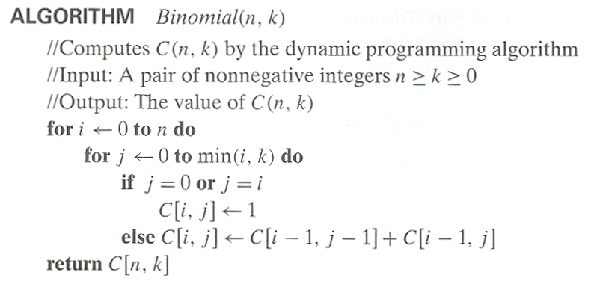
Bottom-up algorithm to compute Binomial Coefficient using Dynamic Programming technique

Slide 23
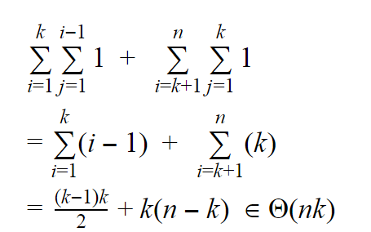
Time complexity:

Slide 24
Exercise for students:
Write a top-down algorithm to compute Binomial Coefficient using Dynamic Programming strategy.

Slide 25
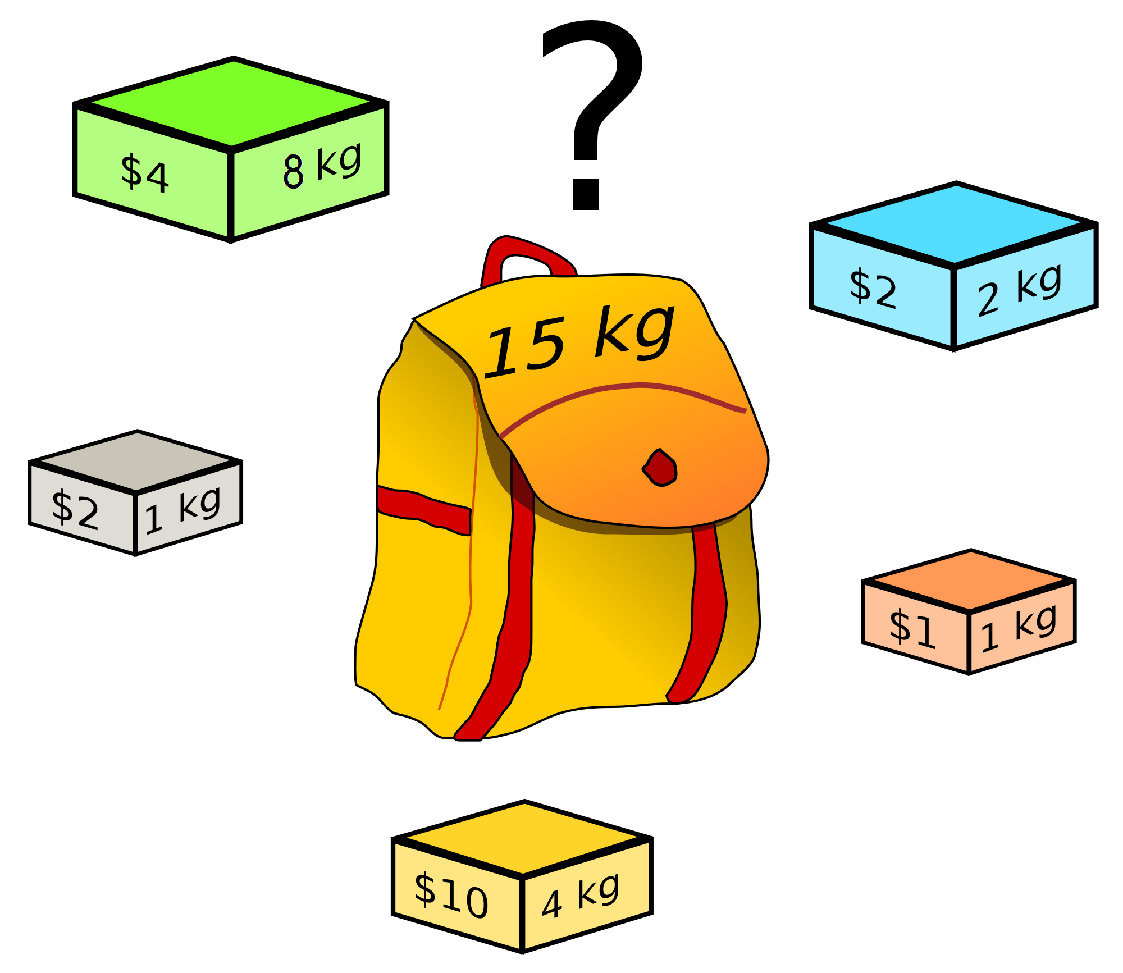
Knapsack Problem:
Given n items:
weights: w₁ w₂ … w_{n}
values: v₁ v₂ … v_{n}
a knapsack of capacity W
Find most valuable subset of the items that fit into the knapsack.

Slide 26
Knapsack Problem:
f(v[1..n], w[1..n], W)
if(w[n] > W) return
f(v[1..n-1],w[1..n-1],W)
return
max(v[n] + f(v[1..n-1],
w[1..n-1], W-w[n]),
f(v[1..n-1],w[1..n-1],W))

Slide 27
Knapsack Problem:
f(v[1..n], w[1..n], W)
if(n=0 OR W=0) return 0
if(w[n] > W) return
f(v[1..n-1],w[1..n-1],W)
return
max(v[n] + f(v[1..n-1],
w[1..n-1], W-w[n]),
f(v[1..n-1],w[1..n-1],W))

Slide 28

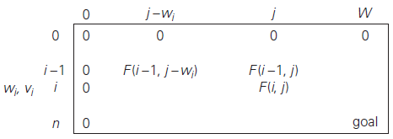
Knapsack Problem and Memory Functions

Slide 29
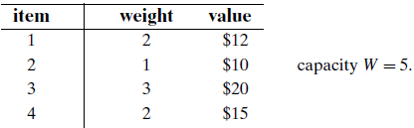
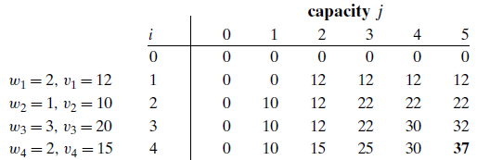
Knapsack Problem

Slide 30
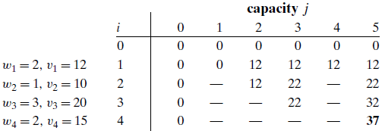
Knapsack Problem and Memory Functions

Slide 31
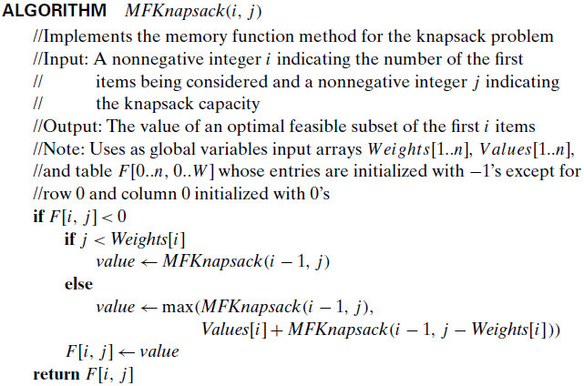

Slide 32
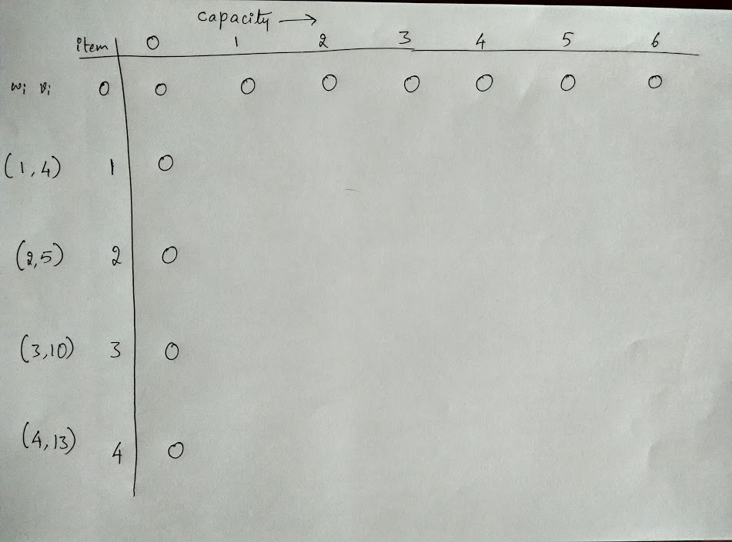

Slide 33
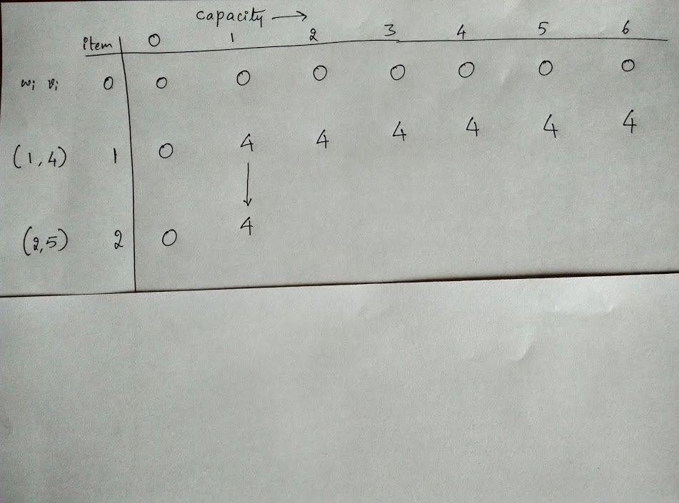

Slide 34
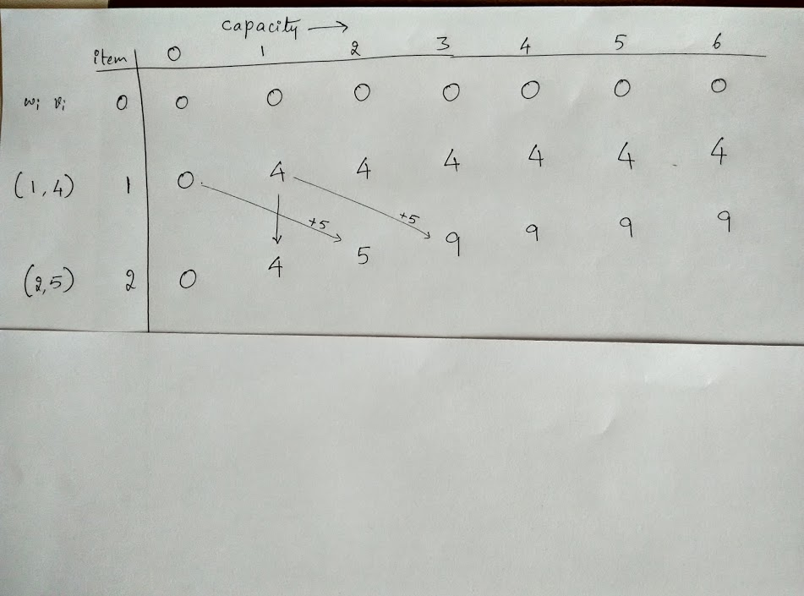

Slide 35
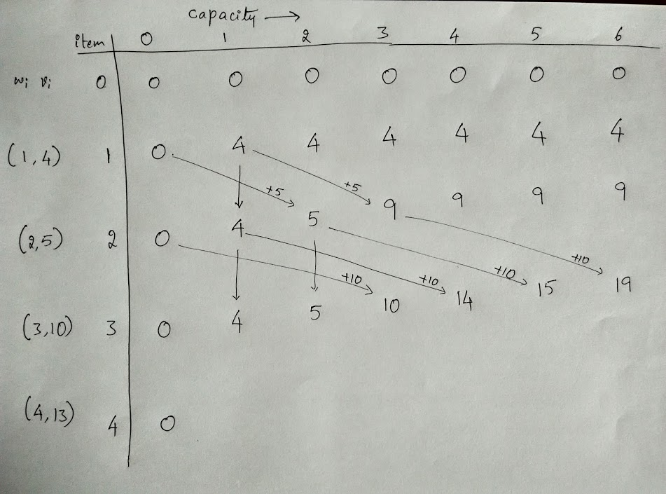

Slide 36
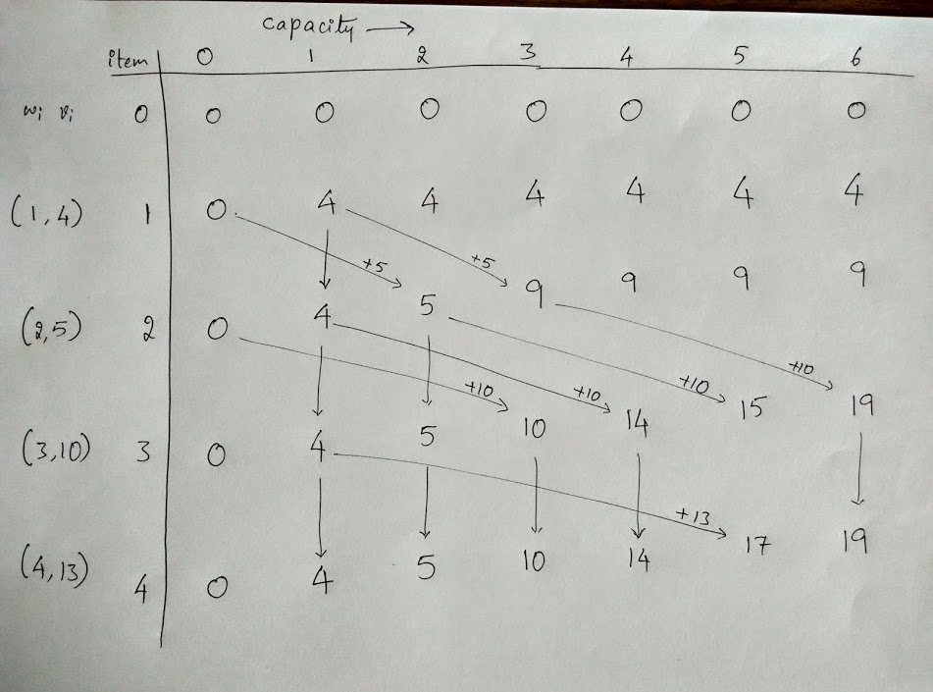

Slide 37
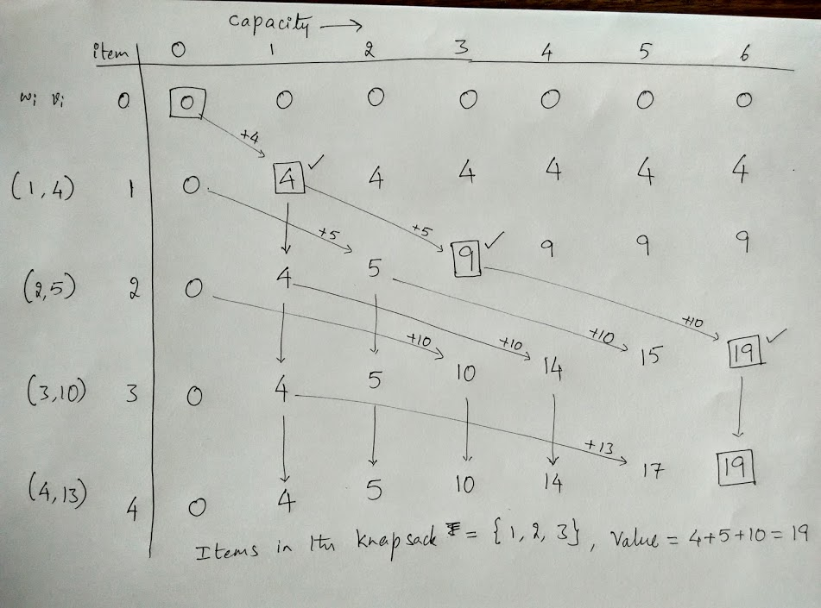

Slide 38
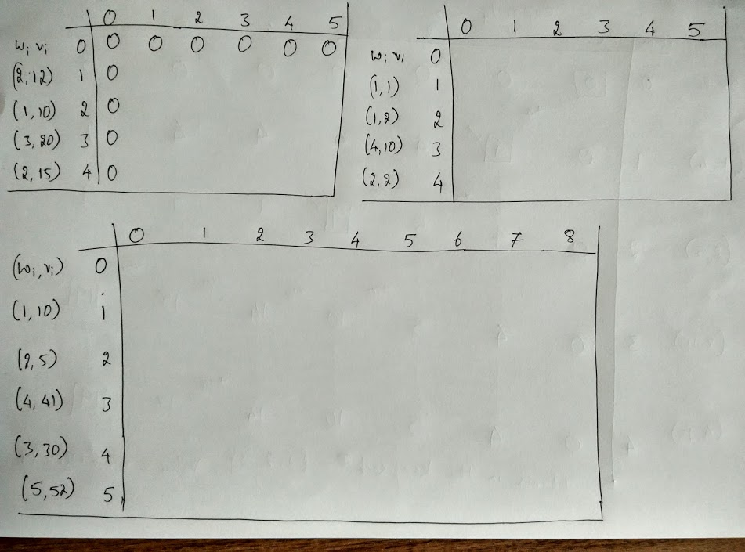

Slide 39
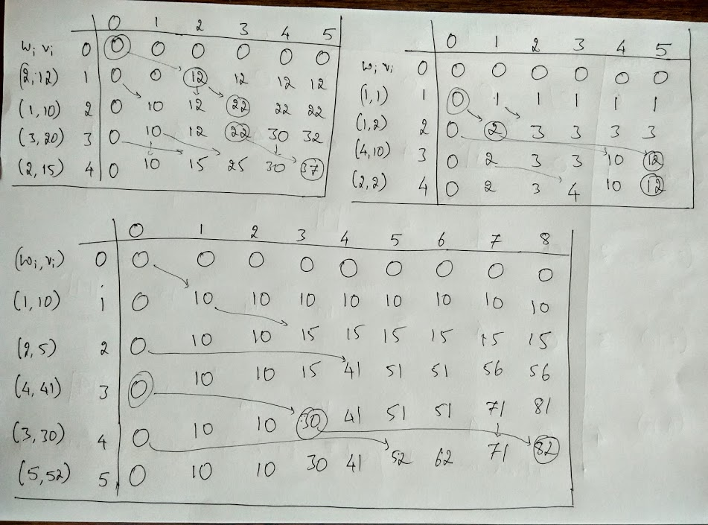

Slide 40
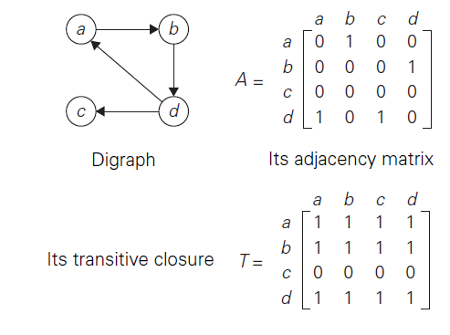
Transitive closure of a digraph
to find all-pairs-reachability in a digraph

Slide 41
Finding Transitive Closure of a digraph
for i …
for j …
for k …
if( A[i,j] AND A[j,k])
then A[i,k] = 1
O(n³)

Slide 42
Finding Transitive Closure of a digraph
for i …
for j …
for k …
if( A[i,j] AND A[j,k]) then A[i,k]=1
O(n³) But, it’s not correct
Flag ← TRUE
while(flag)
flag ← FALSE
for i …
for j …
for k …
if( A[i,j] AND A[j,k] AND A[i,k]=0)
then A[i,k] = 1, flag = TRUE
O(n⁴)

Slide 43
Finding Transitive Closure of a digraph
for each vertex v
dfs(v)
if i is reachable from v
then A[v,i] ← 1
O(n³)
for each vertex v
bfs(v)
if i is reachable from v
then A[v,i] ← 1

Slide 44


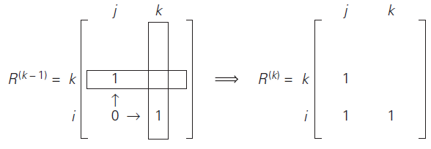
Warshall’s Algorithm

Slide 45
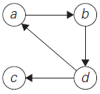
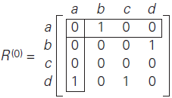
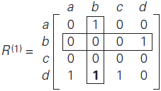
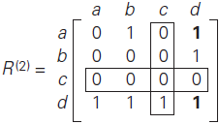
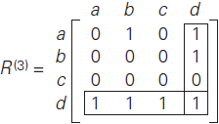
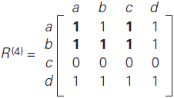

Slide 46
Warshall’s Algorithm
Adjacency Matrix A :
0 1 0 0 0 0
0 0 1 0 0 0
1 0 0 1 0 0
0 0 0 0 1 0
0 0 0 1 0 0
0 0 0 0 1 0
Find the transitive closure of A.

Slide 47
Warshall’s Algorithm
Adjacency Matrix A :
0 1 0 0 0 0
0 0 1 0 0 0
1 0 0 1 0 0
0 0 0 0 1 0
0 0 0 1 0 0
0 0 0 0 1 0
Transitive closure of A :
1 1 1 1 1 0
1 1 1 1 1 0
1 1 1 1 1 0
0 0 0 1 1 0
0 0 0 1 1 0
0 0 0 1 1 0

Slide 48
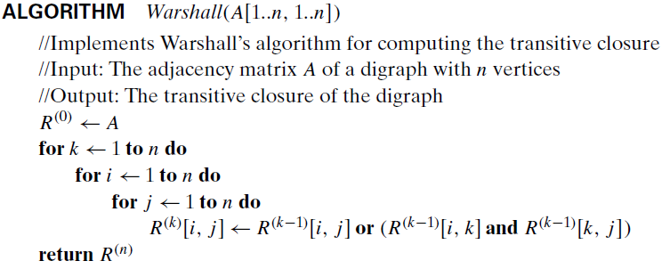

Slide 49
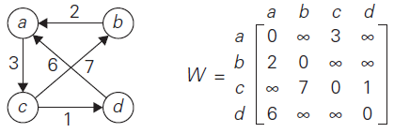
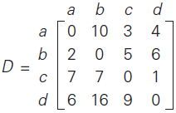
Floyd’s Algorithm
To find all-pairs shortest-paths in a weighted connected graph (undirected or directed) which does not contain a cycle of negative length.

Slide 50



Floyd’s Algorithm
To find all-pairs shortest-paths in a weighted connected graph (undirected or directed) which does not contain a cycle of negative length.

Slide 51
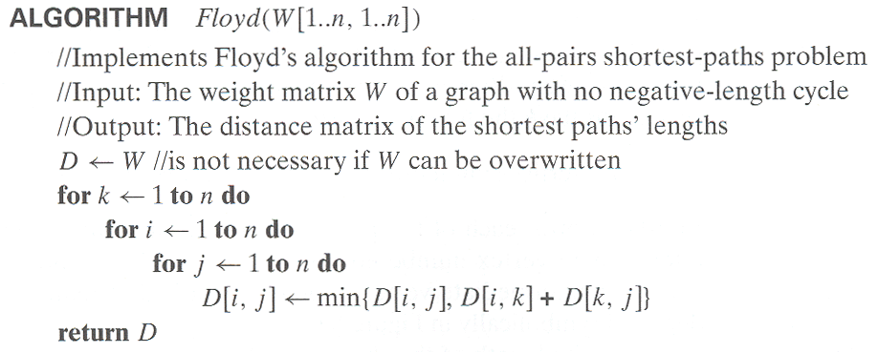

Slide 52
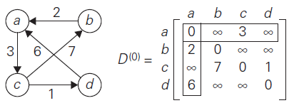
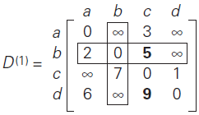
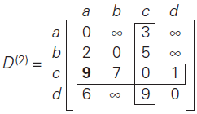
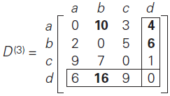
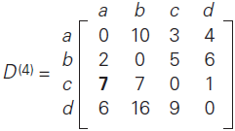

Slide 53
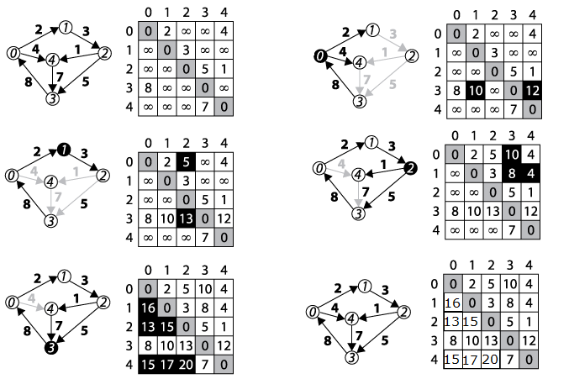

Slide 54
Dynamic Programming is a powerful technique that allows one to solve many different types of problems in O(n²) or O(n³) time for which a naive approach would take exponential time!
</ End of Dynamic Programming >

